Slide 1
Reshaping and Pivoting
There are a number of basic operations for rearranging tabular data. These are alter natingly referred to as reshape or pivot operations.

Slide 2
Reshaping with Hierarchical Indexing
Hierarchical indexing provides a consistent way to rearrange data in a Data Frame. There are two primary actions:
stack : This “rotates” or pivots from the columns in the data to the rows.
unstack : This pivots from the rows into the columns I’ll illustrate these operations through a series of examples.
Consider a small Data‐ Frame with string arrays as row and column indexes:

Slide 3
In[120]:data=pd.DataFrame(np.arange(6).reshape((2, 3)),
.....: index=pd.Index(['Ohio', 'Colorado'], name='state'),
.....: columns=pd.Index(['one', 'two', 'three'],
.....: name='number'))
In [121]: data
Out[121]:
Number one two three
state
Ohio 0 1 2
Colorado 3 4 5

Slide 4
Using the stack method on this data pivots the columns into the rows, producing a Series:
In [122]: result = data.stack()
In [123]: result
Out[123]:
state number
Ohio one 0
two 1
three 2
Colorado one 3
two 4
three 5

Slide 5
From a hierarchically indexed Series, you can rearrange the data back into a Data‐ Frame with unstack:
In [124]: result.unstack()
Out[124]:
Number one two three
State
Ohio 0 1 2
Colorado 3 4 5

Slide 6
By default the innermost level is unstacked (same with stack). You can unstack a dif‐ ferent level by passing a level number or name:
In [125]: result.unstack(0)
Out[125]:
state Ohio Colorado
number
one 0 3
two 1 4
three 2 5

Slide 7
In [126]: result.unstack('state')
Out[126]:
State Ohio Colorado
number
one 0 3
two 1 4
three 2 5

Slide 8
Unstacking might introduce missing data if all of the values in the level aren’t found in each of the subgroups:
In [127]: s1 = pd.Series([0, 1, 2, 3], index=['a', 'b', 'c', 'd'])
In [128]: s2 = pd.Series([4, 5, 6], index=['c', 'd', 'e'])
In [129]: data2 = pd.concat([s1, s2], keys=['one', 'two'])
In [130]: data2
Out[130]:
One a 0
b 1
c 2
d 3
two c 4
d 5
e 6
dtype: int64

Slide 9
In [131]: data2.unstack()
Out[131]:
a b c d e
one 0.0 1.0 2.0 3.0 NaN
two NaN NaN 4.0 5.0 6.0

Slide 10
Stacking filters out missing data by default, so the operation is more easily invertible:
In [132]: data2.unstack()
Out[132]:
a b c d e
one 0.0 1.0 2.0 3.0 NaN
two NaN NaN 4.0 5.0 6.0

Slide 11
In [133]: data2.unstack().stack()
Out[133]:
One a 0.0
b 1.0
c 2.0
d 3.0
two c 4.0
d 5.0
e 6.0
dtype: float64

Slide 12
Pivoting “Long” to “Wide” Format
A common way to store multiple time series in databases and CSV is in so-called long or stacked format.
Let’s load some example data and do a small amount of time series wrangling and other data cleaning:

Slide 13
Pivoting is a common data manipulation technique used to transform data from a “long” format (where each row represents a single observation) to a “wide” format (where each unique value in a column becomes a new column). This is particularly useful when you want to create a summary of the data.
Example:
Let's say you have a dataset containing sales data for different products over several months. The data is in a long format like this:

Slide 14
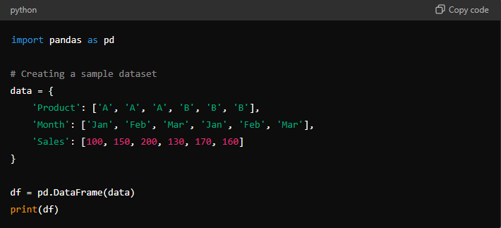

Slide 15
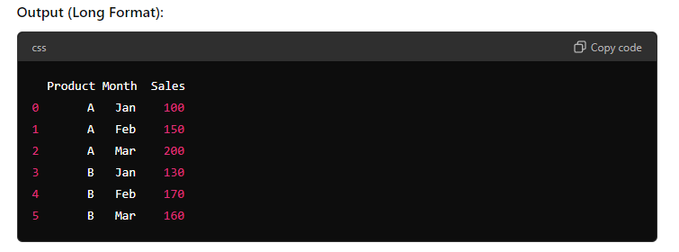
Here, each row represents a single observation for a product in a specific month.

Slide 16
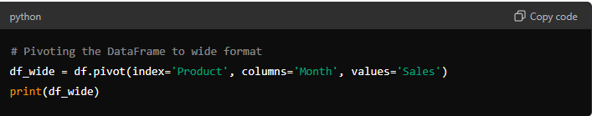
Pivoting to Wide Format
To transform this data into a wide format where each month becomes a separate column, you can use the pivot() function in pandas.

Slide 17
